Slide 1
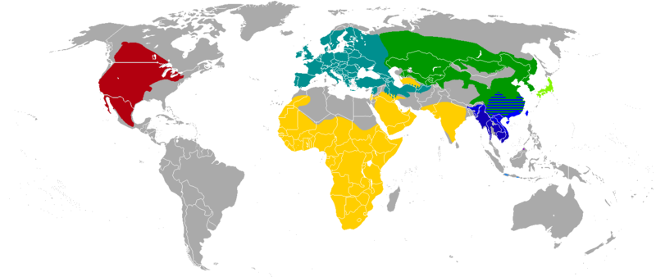
Spatial distribution of species
https://en.wikipedia.org/wiki/File:Badger_species_map.png
Wubing Xu (wubing.xu@idiv.de)
Notes:
Characteristics of species ranges:
Definition of species distribution (scale-dependent)
size (latitudinal pattern, Rapoport hypotheses; measures: Gaston 2009);
shape (north-south vs west-east);
Internal structure within ranges: abundance-center hypotheses
Potential determinants of species ranges:
abiotic, biotic, dispersal
Empirical evidence for range-limiting factors: unequilibrient: glaciation;
Changes of species distributions:
elevational shits;
human activities (Wubing, Ingmar GEB),
extinction risk (mammal, Nature),
biological invasive (Nature)
Database of species distributions
IUCN range maps, GBIF, BIEN

Slide 2
Topics
What and why species distributions
Characteristics of species ranges
Potential determinants of species ranges
Changes in species distributions
Database of species distributions
Notes:
Characteristics of species ranges

Slide 3
The distribution of a species
The geographical locations of all its individuals
during a specified period of time
Lomolino et al. 2010+ Stan Shebs

Slide 4
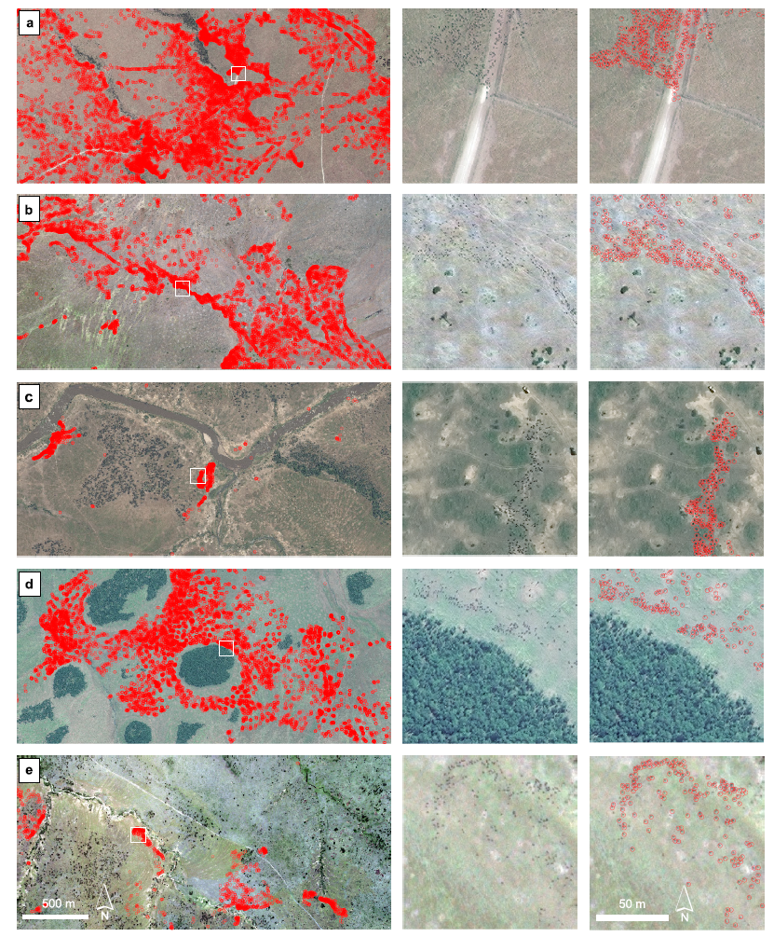
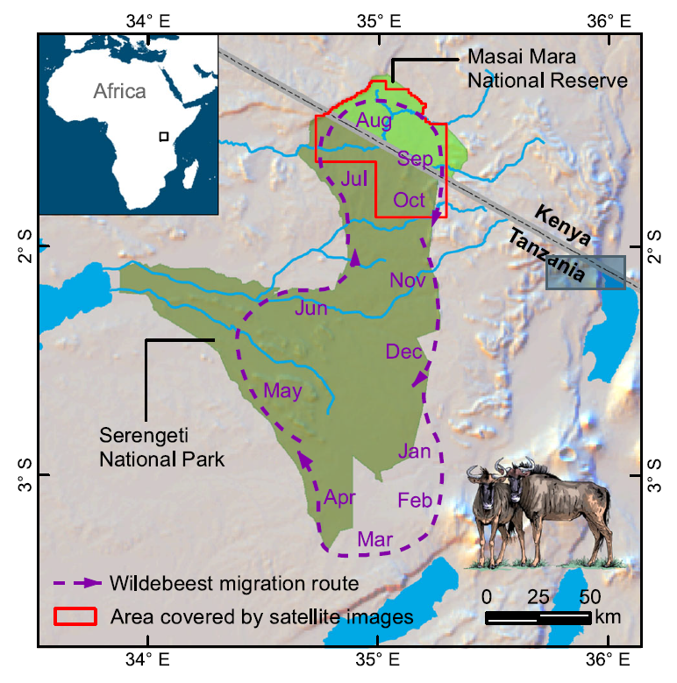
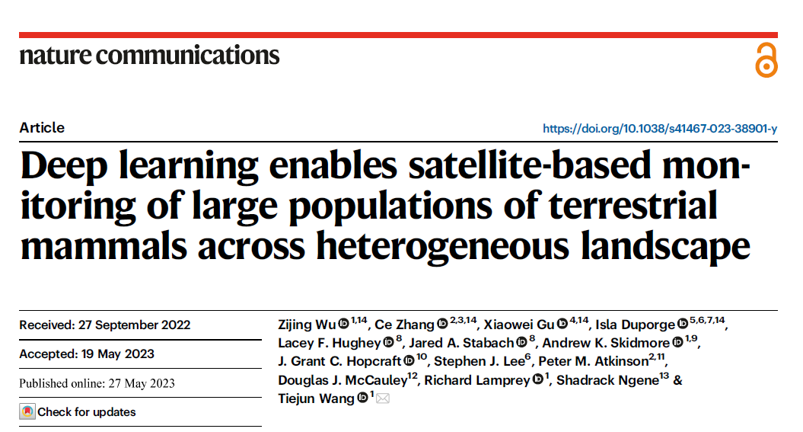
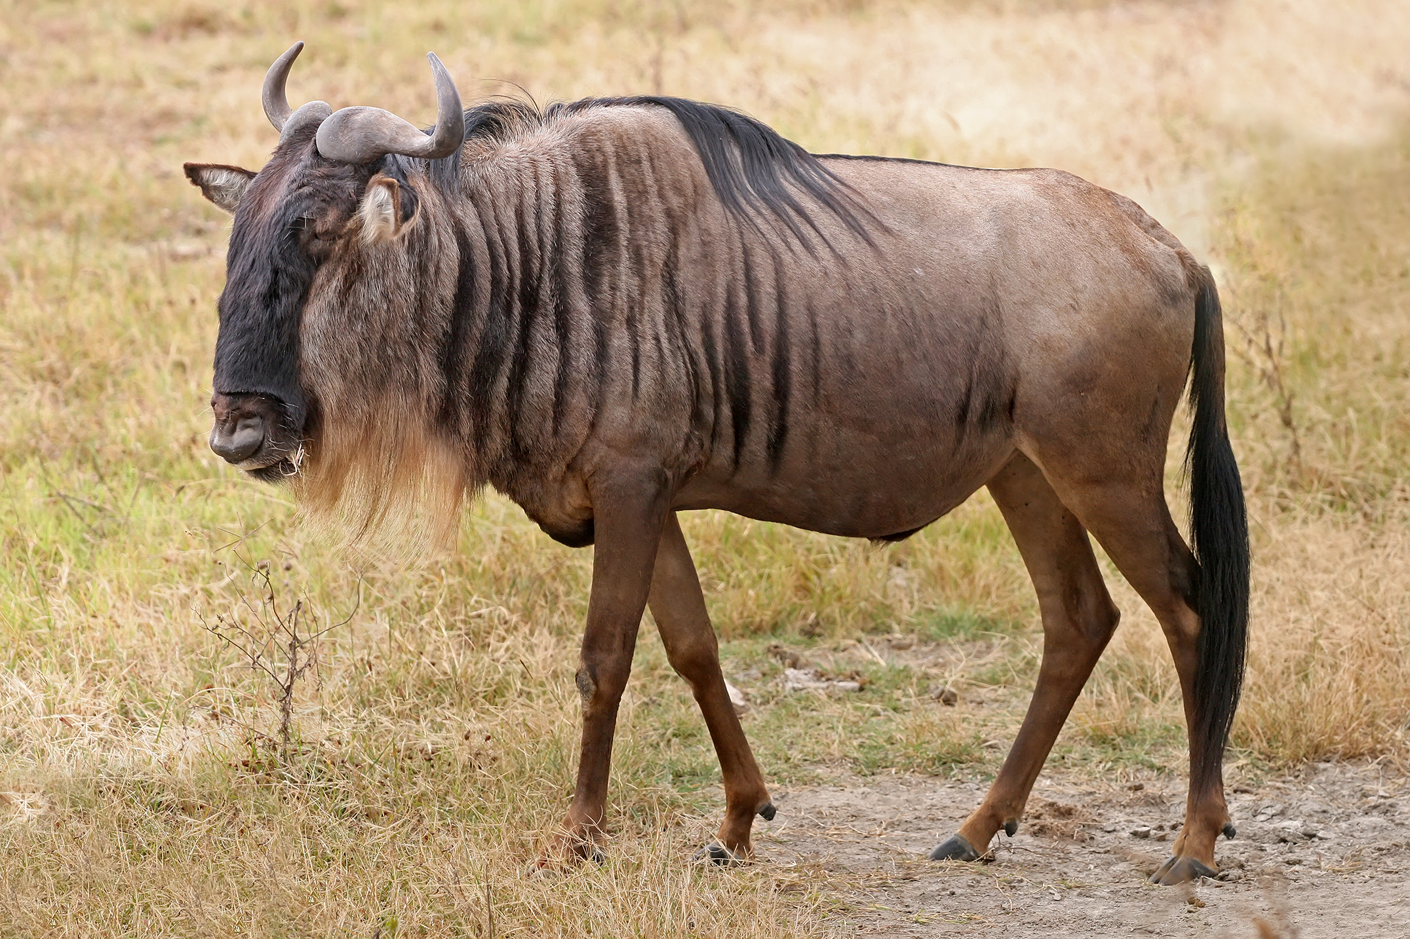
Detected nearly 500,000 individuals of wildebeest across thousands of square kilometers
Notes:
Here, we present a robust transferable deep learning pipeline to
automatically locate and count large herds of migratory ungulates (wildebeest
and zebra) in the Serengeti-Mara ecosystem using fine-resolution (38-50 cm)
satellite imagery. The results achieve accurate detection of nearly 500,000
individuals across thousands of square kilometers and multiple habitat types,

Slide 5
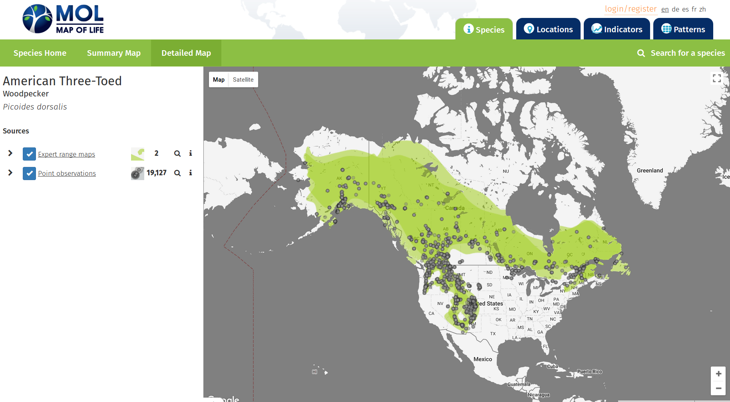
Geographic range – point observations

Slide 6
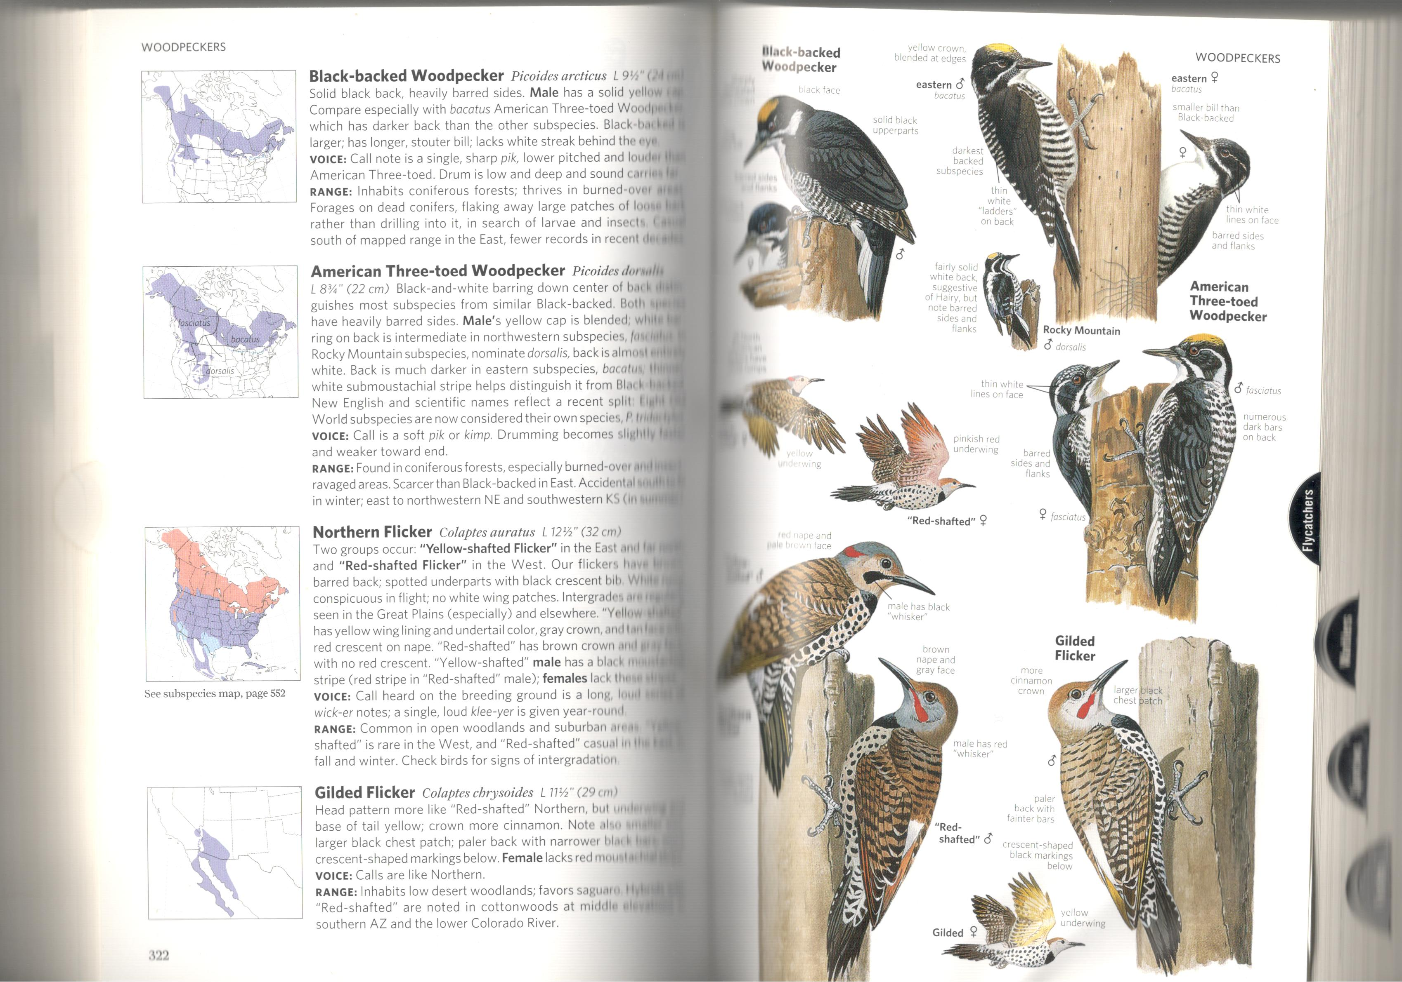
Geographic range – expert range maps

Slide 7
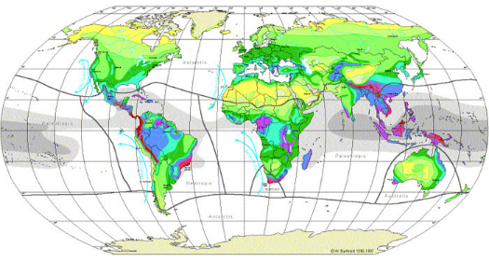
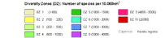
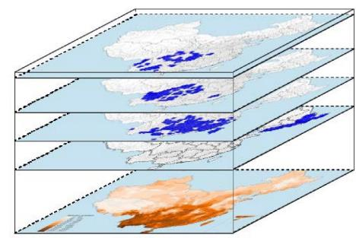
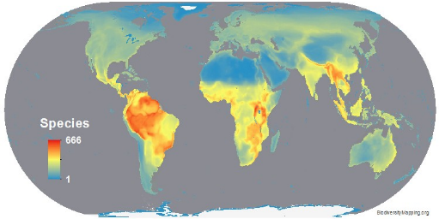
Why species distributions？
Vascular Plants
Species richness = aggregated ranges
Bird Diversity
Wang 2008 PhD thesis

Slide 8
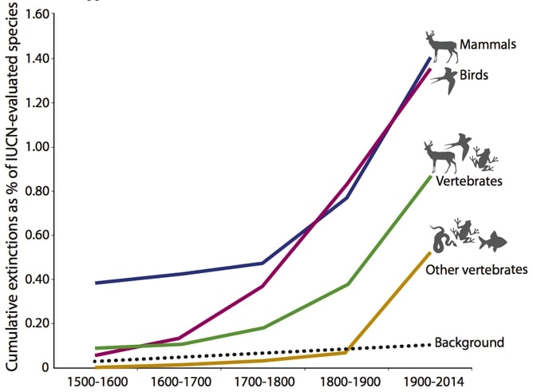
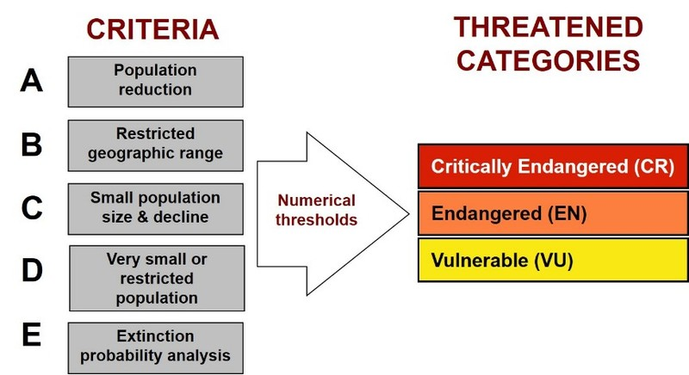
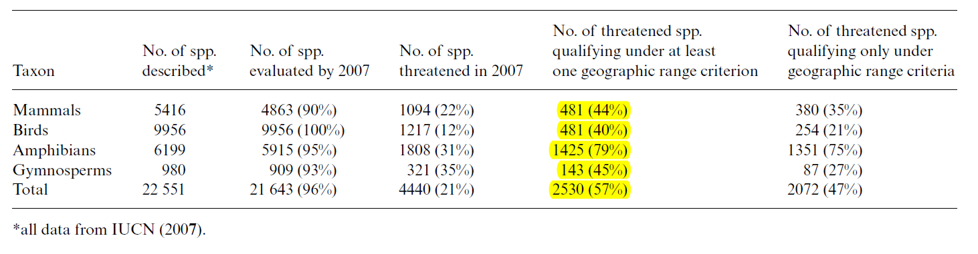
The Sixth Mass Extinction
Gaston 2009, J Appl Ecol
IUCN Red List of Threatened Species

Slide 9
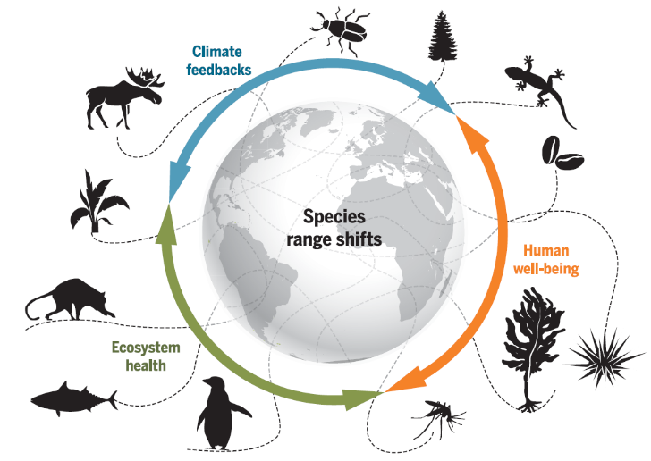
Understanding the factors shaping species’ ranges helps to predict how species range shifts and the impacts on human well-being
Pecl et al. 2017, Science

Slide 10
Characteristics of species ranges
Estimating Range Size

Slide 11

Point observations and geographic range
Georeferenced records (dot maps)
Only presences
Outline maps
Subjectivity
Often no info on abundance
Notes:
Picoides dorsalis

Slide 12
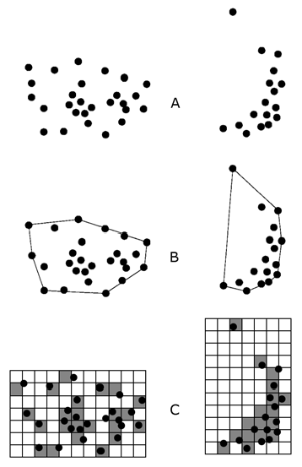
Estimation of range size
EOO (extent of occurrences)
Area within the outermost geographic limits
Minimum convex hull
Include discontinuity of ranges
Capture the geographic spread of localities, so a larger EOO means a less probability that all localities will undergo simultaneous extinction
Point observations
EOO
Gaston & Fuller 2009, J Appl Ecol

Slide 13
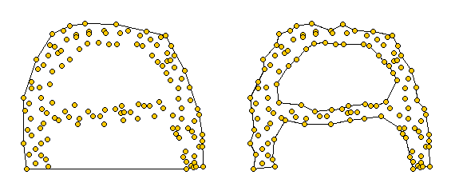
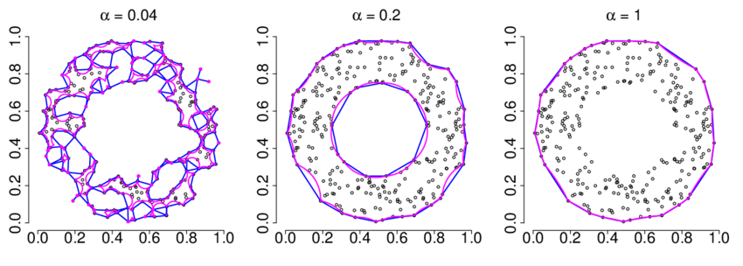
Convex hull vs. alpha hull
Convex hull
alpha hull
A generalization of the convex hull
Notes:
An α–hull constructed by building a Delauney triangulation of the occurrence
points, and removing connecting lines longer than a certain
multiple of the average line length,

Slide 14
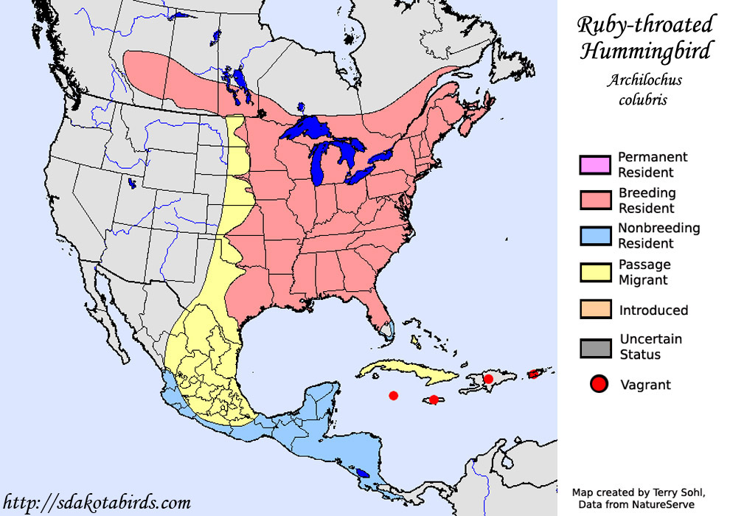
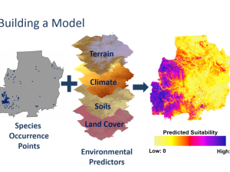
Expert range maps
Species distribution modeling

Slide 15
Estimation of range size
AOO (area of occupancy)
The area that a species actually occurs within geographic limits
Usually based on gridded data
Better correlated with population size than EOO
Point observations
AOO
Gaston & Fuller 2009, J Appl Ecol

Slide 16
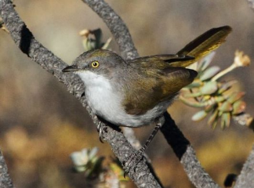
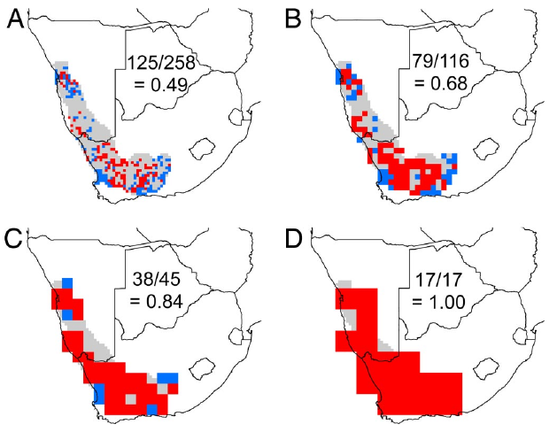
AOO increases with grid resolutions
0.25°
0. 5°
Eremomella gregalis
1°
2°
Range size
Presence
Absence
Grid resolution
Hurlbert & Jetz (2007) PNAS
Notes:
The range map of E. gregalis (gray) in southern Africa, atlas cells in which the species was observed (red), and well surveyed atlas cells in which it was not observed (blue) at 0.25° (A), 0.5° (B), 1° (C), and 2° (D). Values reflect the range occupancy of the species (atlas cell occurrences/total number of well surveyed atlas cells falling within the species' geographic range) at each scale.

Slide 17
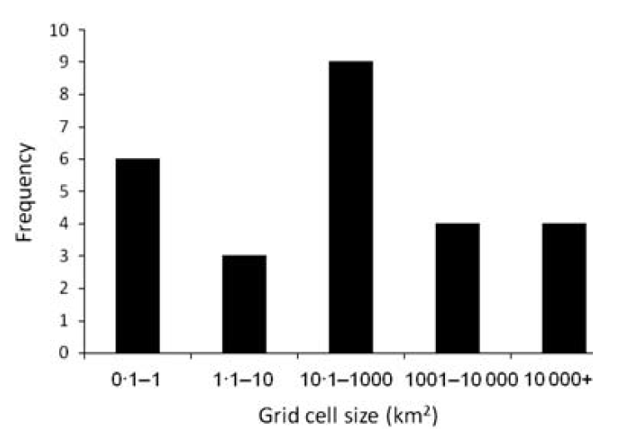
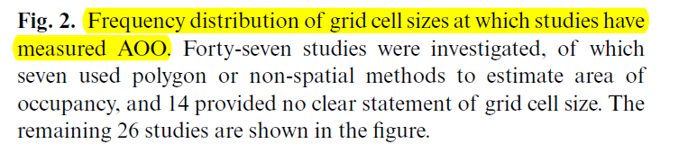

IUCN red list criteria:
2×2 km may be an appropriate one
Greater than 3.2×3.2 km is not useful, because an AOO of 10 km² is used as a threshold to label threatened species
Sampling effort: a fine resolution will increase false absence particularly if very low sampling intensity
Extent of study areas
Halle → Germany → global

Slide 18
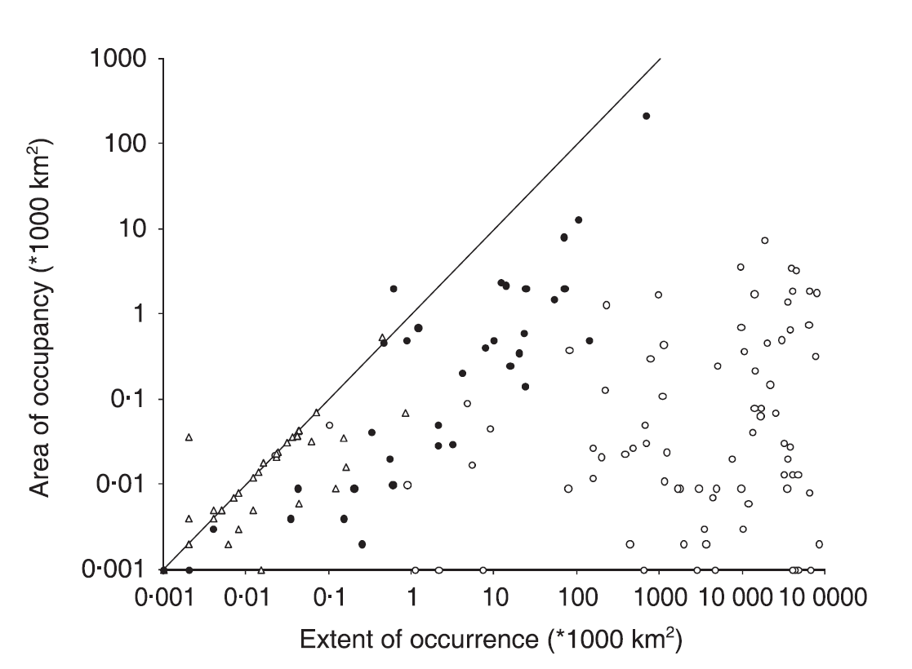
EOO vs. AOO
Relationship between EOO and AOO estimates for the 152 threatened bird species
Different purpose: the spread of localities, distribution within geographic limits
Difference between EOO and AOO sometime is useful
Gaston & Fuller 2009, J Appl Ecol

Slide 19
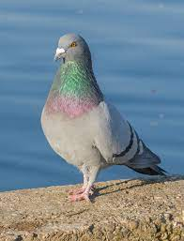
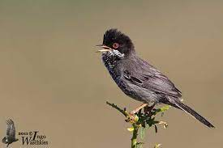

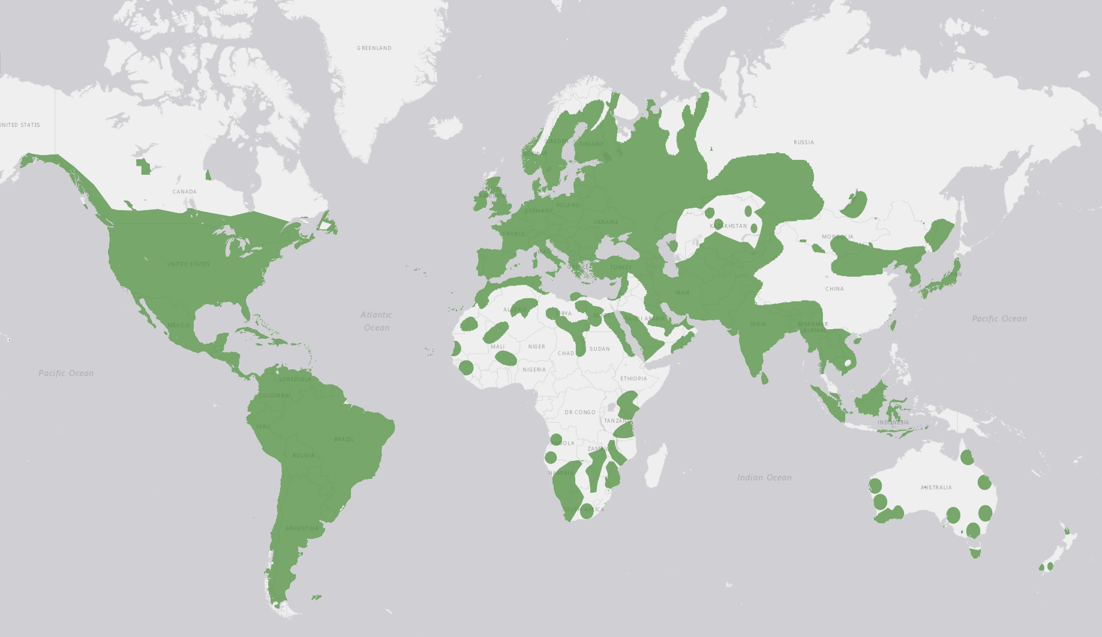
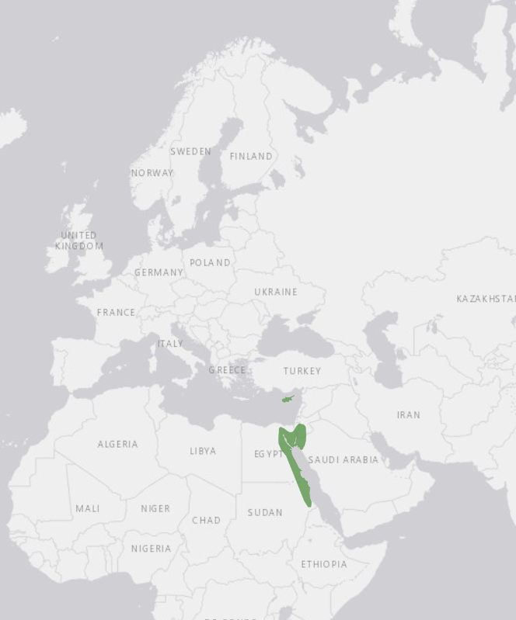
Endemic vs widespread species
Rock dove
(Columba livia)
Cyprus warbler
(Curruca melanothorax)
Notes:
Cyprus WarblerSylvia melanothorax

Slide 20
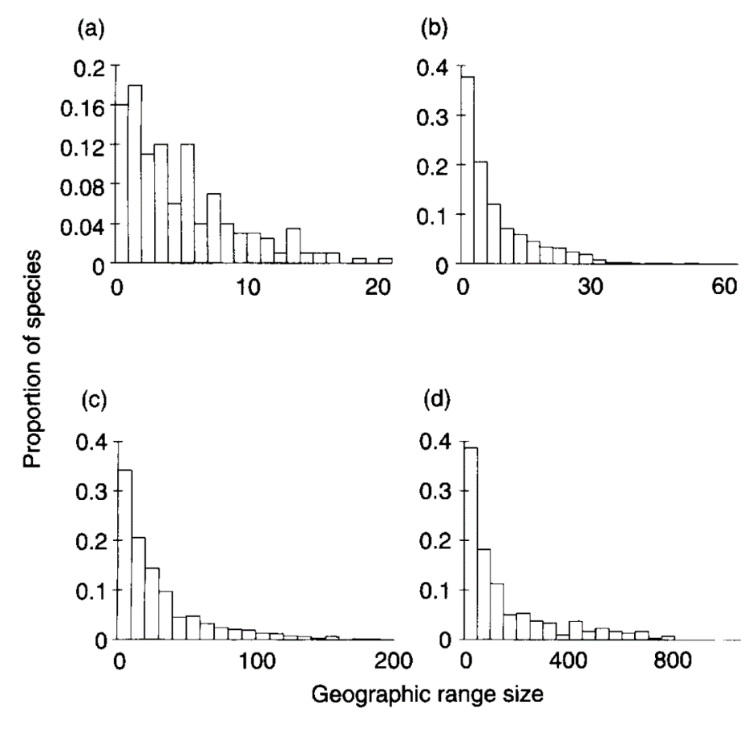
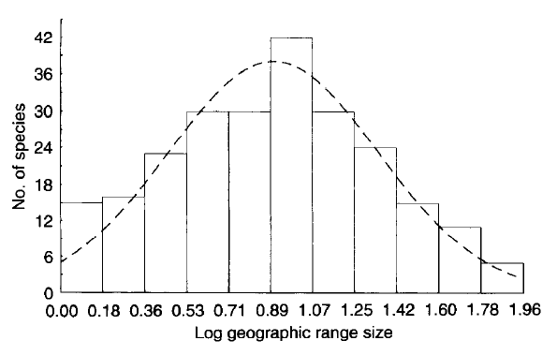
Species-range-size distributions
North America
New world
Log-normal distribution
Africa
Australia
Some examples of bird species in different regions
Gaston, 1996, TREE

Slide 21
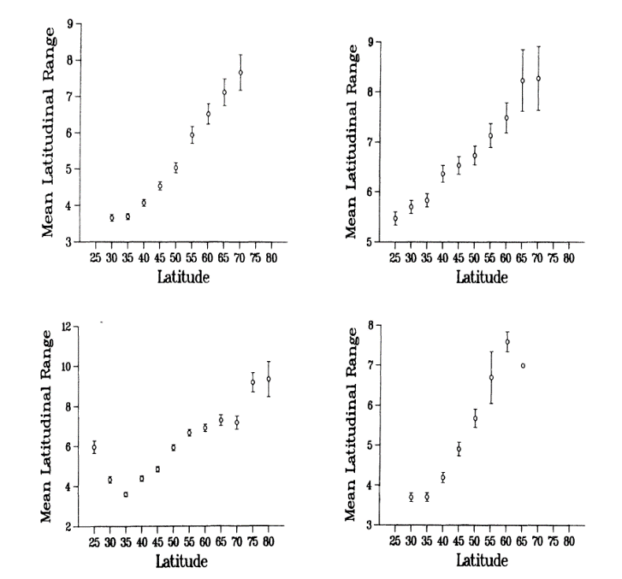
Rapoport’s rule: increasing geographic range sizes with latitudes
Trees
Marine mollusks
Latitudinal patterns of geographic range sizes for different taxa in North America
Freshwater/coastal fishes
Reptiles and amphibians
Stevens 1989, American Naturalist

Slide 22
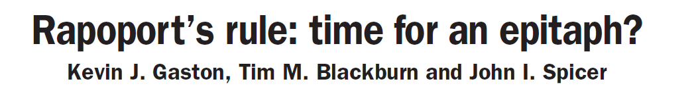
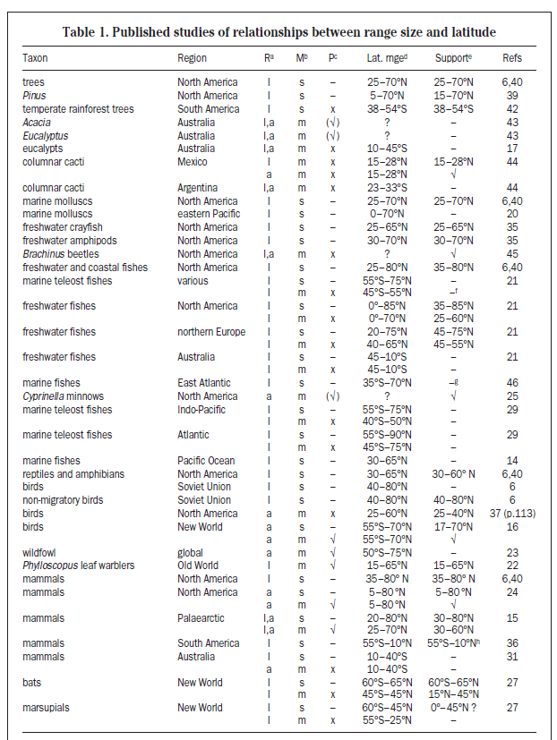
A lot of debate
Maybe a local phenomenon restricted to high latitudes in the northern hemisphere
Promote discussion of spatial variation in geographic range sizes
Gaston, 1998, TREE

Slide 23
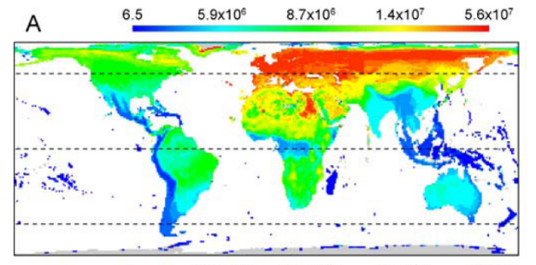
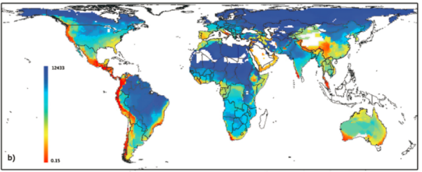
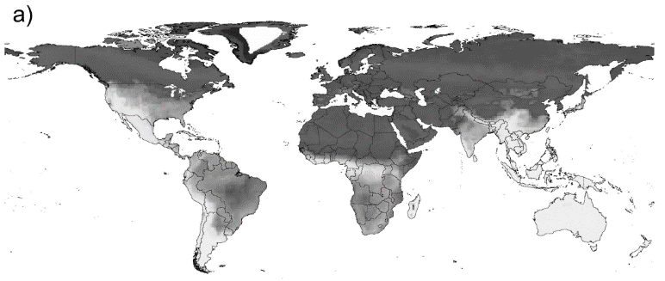
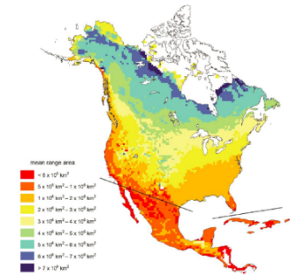
Geographic patterns of species’ range size
Amphibians (Whitton et al. 2012)
Birds (Orme et al. 2006)
Overall, small ranges are mostly distributed in islands, mountains and low latitudinal areas
Mammals (Davis et al. 2009)
Trees (Morin et al. 2011)
Notes:
Overall, small ranges are mostly distributed in islands, mountains and low latitudinal areas
很多研究发现物种的分布区大小在空间上并不是均匀分布的，有些地区的物种分布区比较大，而另外一些地区的比较小。这里展示的是全球两栖类、鸟类、哺乳动物和北美乔木树种的格局，总体上看，较小的分布区出现在岛屿、山区和低纬度地区。虽然已经有了不少研究，但格局背后的机制还存在很多争论，特别是关于植物的分布区大小格局，主要受限于分布数据还比较缺乏。

Slide 24
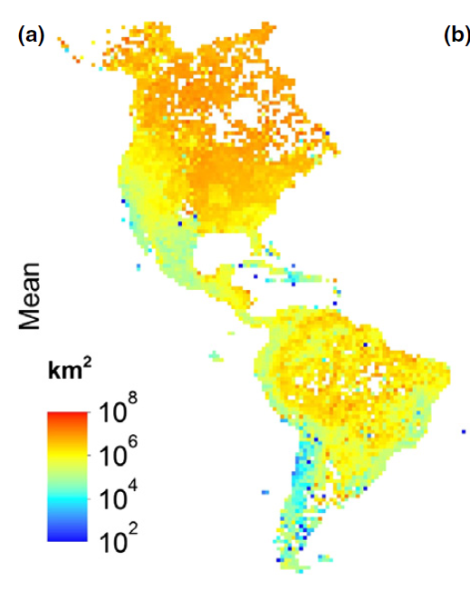
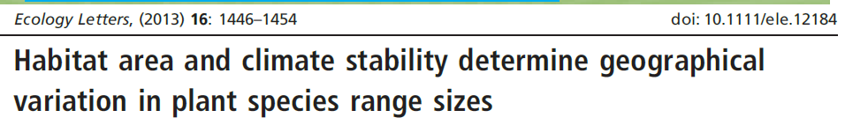
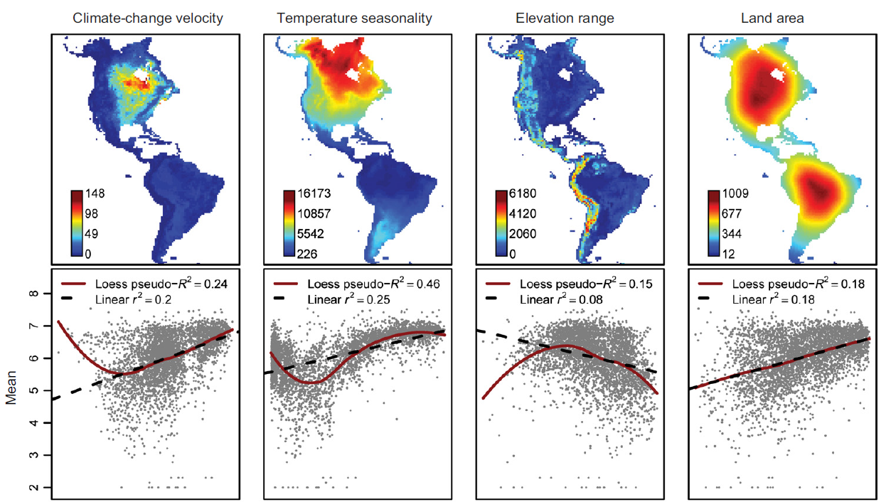
Land area
Climatic seasonality
Past climate change through geological time
…
Notes:
那怎么解释分布区大小空间格局呢，现在提出了很多假说，现在有两个假说受到的关注比较多。第一个:高的气候季节性 → 宽的环境耐受范围和生态位宽度→ 大的分布区 (Stevens, 1989).
另外一个假说是古气候不稳定性假说，或者描述为差异性灭绝假说。对于我们的气候系统，长时间尺度看，它不是一直不变的，是不断震荡的。气候变化了物种需要迁移其分布区，在这过程中分布区小和扩散能力弱的物种更高灭绝速率

Slide 25
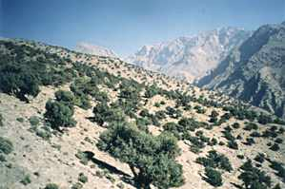
Internal range structure
Spatial variation in presence and abundance within ranges
Species 1
Distributions of individuals
Similar extent of occurrences (EOO)
Different areas actually occupied (AOO)
Species 2
Juniper distribution

Slide 26
How are individuals distributed w/in a species’ range?
Aggregated
Aggregated distribution are ubiquitous
Regular
Random
Lomolino et al. 2010+ www

Slide 27
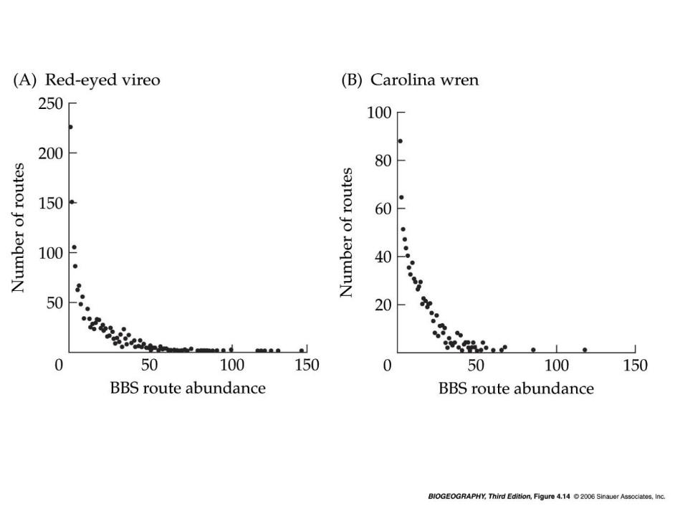
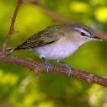
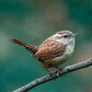
Spatial variation in abundance
Any given species is typically only abundant at a minority of its occupied sites (’hotspots’)
For both species, only one individual was recorded on the majority of routes.
Notes:
results of standardized census routes of the North American Breeding Bird Survey.

Slide 28
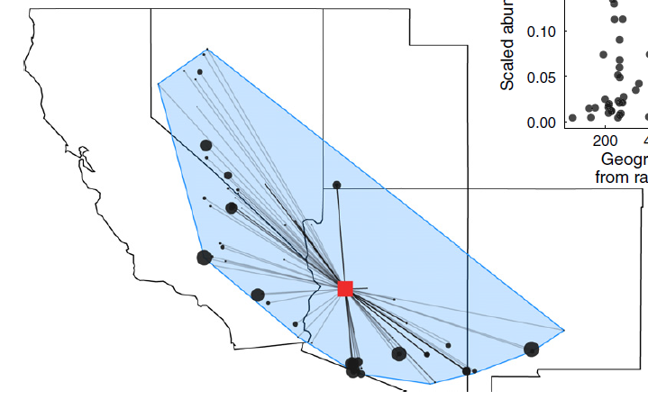
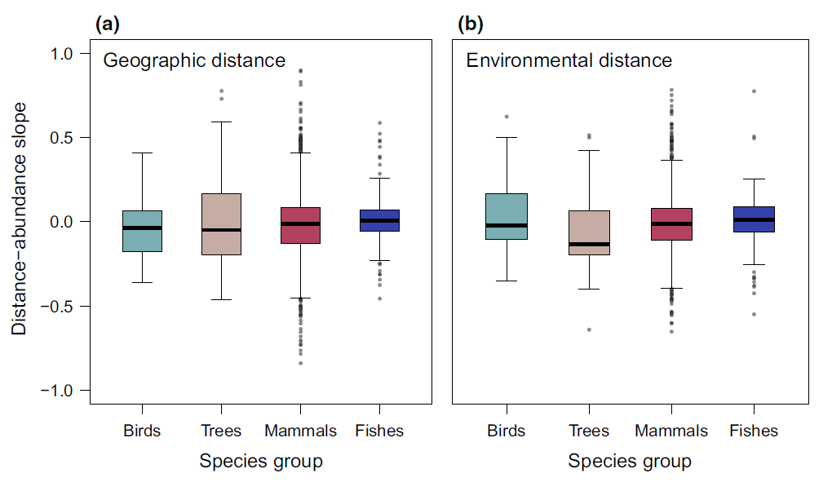
Abundant-centre hypothesis
Prediction
High abundance in centers of geographic ranges and environmental space
Abundance
Center
Margin
Geographical/environmental space
Weak relationship based on 1600 species
Dallas et al. 2017, Ecol Lett

Slide 29
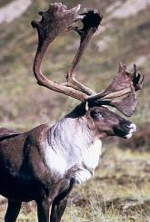
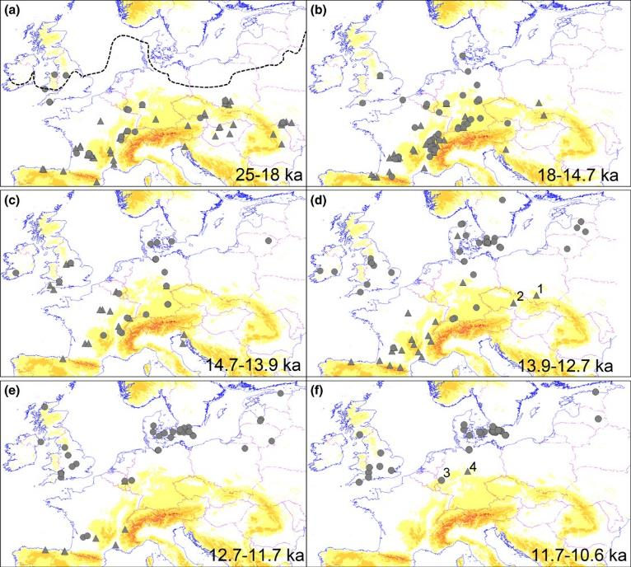
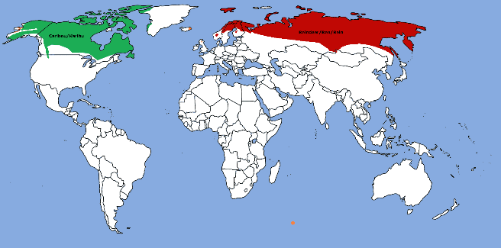
Long-term dynamics of ranges
Points: Locations of fossil records
Reindeer
(Rangifer tarandus)
The margin of the ice sheet
Today
Sommer et al. 2014. J. Biogeogr.
Notes:
https://de.wikipedia.org/wiki/Ren
The dotted line in panel (a) indicates the margin of the ice sheet
The yellow indicate topography

Slide 30
Potential determinants of species distributions
Which factors?
Click: Jam Board
Notes:
Potential determinants of species distributions
Potential causes of geographic range limits

Slide 31



Fundamental factors in Soberón’s framework
biotic factors
Abiotic factors
J Soberón 2007 Ecol Lett 10:1115-1123.
Accessible given the dispersal capacities (migration)

Slide 32

(Grinnellian) Niche - tolerance limits
Environmental Gradient
All species have tolerance limits for environmental factors beyond which individuals cannot survive, grow, or reproduce

Slide 33

Treeline in southern Alps
Treeline is the upper elevational limit of trees on mountains.
Seems to be related to temperature, wind, snow depth etc.
Photo by M. Y. Bader

Slide 34
Niche breadth
niche breadth
Environmental gradients
Range size increase with niche breadth?

Slide 35


Range size vs. niche breadth
Synthesize 64 studies
A significant positive relationship between range size and environmental tolerance breadth (z = 0.49), habitat breadth (z = 0.45), and diet breadth (z = 0.28).
Slatyer & Sexton 2015, Ecol Lett

Slide 36


Biotic interaction
Competition for food
1. Competition
2. Predation (or parasitism)
3. Mutualism
Predation
Mutualism (pollination )
Notes:
African lions and hyaenas compete for food.
Predation in action. Leopard—Panthera pardus—killing a young bushbuck—Tragelaphus sylvaticus by NJR ZA, CC BY-SA 3.0

Slide 37




Competition
The effects of introduced grey squirrel (Sciurus carolinensis) on the native red squirrel (Sciurus vulgaris)
Sciurus carolinensis
Sciurus vulgaris
Distribution maps of red (red square) and grey (grey square) squirrels in Piedmont, Italy, from 1970 to 2010.
Bertolino et al. 2014 Biol. Invasions
Notes:
Grey squirrel adapt to climate and habitats in both North and South Europe, causing extinction of the native red squirrel
Rather much circumstantial evidence for mammals & birds
Probably less important in plants!
Why?
Because plants are sessile & interactions local
Red and grey squirrels

Slide 38

Top-down and bottom-up effects
Notes:
There are a couple of ways in which predator-prey interactions can influence distribution patterns:
Predators that rely on specific prey are restricted by the distribution of the prey.
Predators may limit prey distributions by killing and eating prey organisms.

Slide 39
Mutualisms
Mutualisms are interspecific interactions in which both species benefit.
Pollination
Dispersal seed
Mycorrhiza–plants

Slide 40


Biotic vs abiotic range limits – geographical patterns?
Abiotic?
Cool margin
Warm margin
Biotic?
Results based on 338 studies including 1931 assessments of potentially range-limiting factors.
Paquette & Hargreaves 2022, Ecol Lett

Slide 41

Dispersal effects on range limits
+ presence
absence
Source-sink dynamics
species may occur in environmental unsuitable sink habitats
r < 0
r > 0
r = intrinsic
population
growth rate in
the absence of
immigration
Dispersal limitation
Some suitable habitats maybe not occupied
r < 0
r > 0
Pulliam (2000) Ecol Lett 3:349-361.
Notes:
the solid oval refers to the fundamental niche or the combination of environmental factors (e₁ and e₂) for which the species has a finite rate of increase (λ) greater than or equal to 1.0.

Slide 42



Dispersal effects
Are species ranges in equilibrium with current environment (climate etc)?
To what extent have species failed to occupy suitable areas?
Equilibrium = unlimited dispersal
Non-equilibrium = dispersal limitation

Slide 43

Limited range filling
Ecological niche modelling
Realized/Potential range size, R/P: median = 30% (55 tree species)
Widespread naturalization beyond the native range
Interpretation:
Low range filling mainly reflects (postglacial) dispersal limitation
●Native and naturalized occurrences
Svenning & Skov 2004 Ecoly Lett

Slide 44
Scale-dependency of range limiting factors
Summary of empirical evidence
Modified from Pearson & Dawson, 2003, GEB

Slide 45

We are living in the Anthropocene
Notes:
The Anthropocene (/ˈænθrəpəˌsiːn, ænˈθrɒpə-/ AN-thrə-pə-seen, an-THROP-ə-)^{[1][2][3][failed verification]} is a proposed geological epoch dating from the commencement of significant human impact on Earth's geology and ecosystems, including, but not limited to, anthropogenic climate change
The 2022 projections from the United Nations Population Division (chart #1) show that annual world population growth peaked at 2.3% per year in 1963, has since dropped to 0.9% in 2023, equivalent to about 74 million people each year, and projected that it could drop even further to minus 0.1% by 2100.^{[4]} Based on this, the UN projected that the world population, 8 billion as of 2023, would peak around the year 2086 at about 10.4 billion, and then start a slow decline

Slide 46





Human changes species distributions
Overexploitation
Climate change
Habitat loss
Pollution
Biological invasion

Slide 47






Range dynamics of
five megafauna species
over the past 2 millennia
Mainly explained by increased agricultural land and agricultural intensification
Time
Teng et al. 2020, PNAS
Notes:
Mainly explained by increased agricultural land and agricultural intensification

Slide 48

Historic # species
# species lost
Proportion of species lost
173 mammal species collectively lost over 50% of their historic range area
Ceballos & Ehrlich, 2002, Science

Slide 49



Climate warming drive range shifts?
Shift to high latitudes
Shift to high elevations

Slide 50


Compare the altitudinal distribution of 171 forest plant species between 1905-1985 and 1986-2005 along the elevations (0 to 2600 m) in west Europe,
A significant upward shift in species optimum elevation averaging 29 meters per decade

Slide 51


Range shifts along latitudes
35 species of European butterflies
In 63 % range shifted north (35-240 km) during the 20th century, and only 3% shifted south
Twentieth-century changes in the range of Pararge aegeria in Great Britain
1915-1939
1940-1969
1970-1997
Parmesan et al. 1999, Nature
Notes:
A coloured grid cell indicates more than one population in 1915–1939 (black), 1940–1969 (red) or 1970–1997 (blue).

Slide 52



Terrestrial
Marine
Based on a global geo-database of 30,534 range shifts
Notes:
BioShifts—a global geo-database of 30,534 range shifts.

Slide 53


Human facilitate species dispersal
Intentionally: e.g. ornamental species trade
Unintentionally: e.g. organisms attach to the submerged part of a ship or contain within their ballast waters
Notes:
introduced species are transported either intentionally or accidentally by human-mediated vectors into habitats outside their native range

Slide 54

Global accumulation of non-native plants
13,168 plant species have become naturalized somewhere
3.9% of global vascular flora, or approximately the size of the native European flora
van Kleunen et al. 2015, Nature
Notes:
Continents in the Northern Hemisphere have been the major donors of naturalized alien species to all other continents.

Slide 55

Regions with greater GDP per capita, human population density have higher alien richness
Dawson et al. 2017, Nature Ecol Evol
Notes:
Regions with greater gross domestic product per capita, human population density, and area have higher established alien richness, with strongest
effects emerging for islands.

Slide 56

Winners and losers
Range size may matters: small- vs large-ranged species
A positive relationship between range size and niche breadth
A positive relationship between range size and dispersal ability are more common
Large-ranged species are more likely to persist and expand distributions in response to global environmental changes
Notes:
Why invasive?

Slide 57


Hypotheses: occupancy change ~ range size
Xu et al., 2023, Nature Communications
Notes:
Why invasive?

Slide 58


239 metacommunities
An overall positive relationship between range size and occupancy change
The positive effects were stronger in marine than terrestrial and freshwater realms
Xu et al., 2023, Nature Communications

Slide 59

Whether protected areas can mitigate directional changes?
Terrestrial habitat protection can mitigate systematic biodiversity changes
Notes:
The effect of range size on occupancy change was weaker in protected terrestrial regions
Habitat protection might be successful in mitigating systematical biodiversity changes

Slide 60
Afternoon: access and use species distribution data

Slide 61




Sources of species distribution data
Specimens
Occurrence observations
eBrid
Model predicted
Samples of community
Expert range maps

Slide 62
eBrid
Data infrastructure storing/processing species distributions

Slide 63



GBIF
https://www.gbif.org/
R package: rgbif

Slide 64

OBIS (Ocean Biodiversity Information System)
https://obis.org/

Slide 65


Georeferenced plant occurrences
Plot inventories
Species geographic range maps
Plant traits
Phylogeny
R package: BIEN
Notes:
BIEN is a network of ecologists, botanists, and computer scientists working together to document global patterns of plant diversity, function and distribution.
Here you will find access to:
Georeferenced plant observations from herbarium, plot, and trait records;
Plot inventories and surveys;
Species geographic distribution maps;
Plant traits;
A species-level phylogeny for all plants in the New World;
Cross-continent, continent, and country-level species lists.

Slide 66




World Checklist of Vascular Plants (WCVP)
R package: rWCVP
https://cran.r-project.org/web/packages/rWCVP/vignettes/rWCVP.html
Notes:
Fagus sylvatica L.

Slide 67



IUCN expert range maps
https://www.iucnredlist.org/resources/spatial-data-download
The IUCN Red List of Threatened Species™ contains global assessments for more than 150,300 species. More than 82% of these (>123,600 species) have spatial data.

Slide 68

https://mol.org/

Slide 69
Use range maps in R
Use IUCN and BIEN range maps
Calculate range size
Rasterize range maps
Use GBIF occurrences
Exercise
Notes:
Spatial data type
rgbif tutorial: https://docs.ropensci.org/rgbif/
WCVP tutorial: https://cran.r-project.org/web/packages/rWCVP/vignettes/rWCVP.html

